Slide 1
Paxlovid
&
Dysgeusia

Slide 3
What is Paxlovid
Paxlovid is a Investigational drug to treat covid-19
A investigational drug is a drug still being studied.
It is the first oral treatment for covid-19
Paxlovid consists of two different types of tablets. Nirmatrelvir and Ritonavir.
Paxlovid is taken twice a day and you take three tablets both times. Two Nirmatrelvir(150mg each) tablets and one Ritonavir(100mg) tablet. You do this for five days. Pfizer says that if you still have symptoms after five days you should see a doctor. Paxlovid at the moment isnt supported or sold in units for more than five days.
Commissioner, O. of the. (n.d.). Coronavirus (COVID-19) update: FDA authorizes first oral antiviral for treatment of covid-19. U.S. Food and Drug Administration. Retrieved June 24, 2022, from https://www.fda.gov/news-events/press-announcements/coronavirus-covid-19-update-fda-authorizes-first-oral-antiviral-treatment-covid-19
Fact sheet for patients, parents, and caregivers emergency use ... - pfizer. (n.d.). Retrieved June 24, 2022, from https://labeling.pfizer.com/ShowLabeling.aspx?id=16473

Slide 4
Is Paxlovid Right For You?
Paxlovid is currently still being studied as I said before however it has been shown to decrease the risk of being hospitalized due to covid-19 in cases that are mild to moderate.
You also must be older than 12 and must weigh more than 88 pounds(40kg)
Paxlovid also affects lots of drugs or is affected by lots of drugs so make sure about that. Not limited to some anxiety and depression medication.

Slide 5
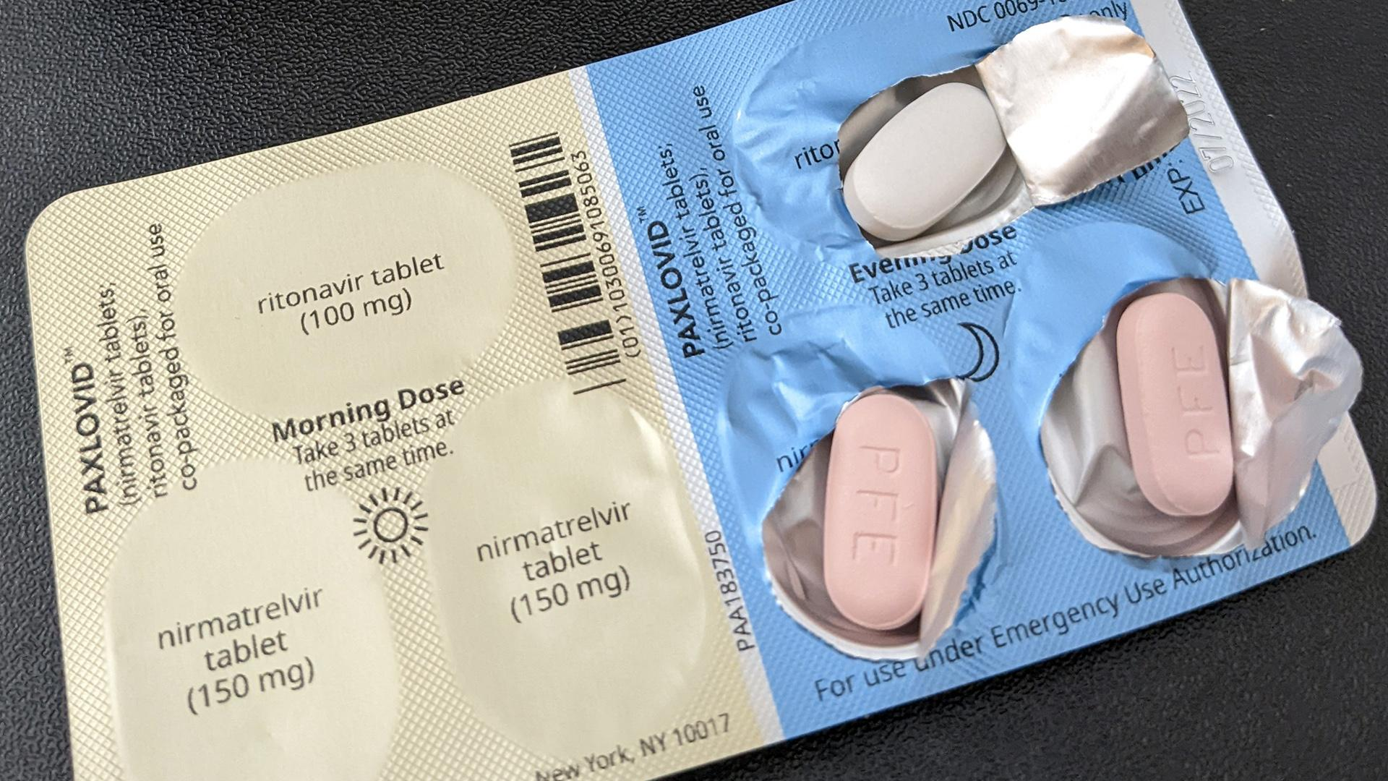
How Does Paxlovid Work?
The Ritonavir which you take one tablet of 100mg. Ritonavir is also a protease inhibitor however it inhibits a enzyme called Cytochrome P4503A4 which usually breaks down drugs in the body's system inhibiting allows for the Nirmatrelvir to stay in the body for longer durations.
The Nirmatrelvir which you take two tablets of 150mg each. The Nirmatrelvir’s job is to inhibit the Main Protease that covid-19 uses.
Notes:
A main protease or 3C-like protease is what covid-19 and some other coronaviruses use to break down proteins.

Slide 6
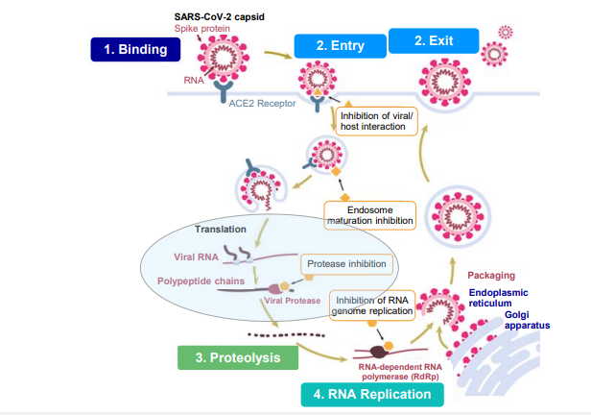
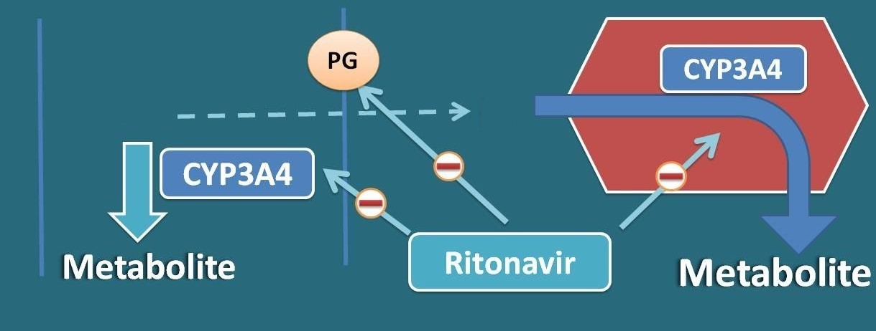
Paxlovid Mechanisms of Action
Nirmatrelivir inhibits the main protease that's job is to process polyprotein precursors which prevents viral replication.
Ritonavir blocks the pathway that the CYP3A4 enzyme uses in the liver as well as it blocks the P-Glycoprotein pump.
Notes:
The job of the 3c like protease is to cleave(separate) the polyprotein into parts that can be read by the cell to create RNA for new viruses.
PG=P-Glycoprotein-

Slide 7
Paxlovids Side Effects
The most common side effects of Paxlovid are Hives,trouble swallowing or breathing,swelling of the mouth, lips, or face,throat tightness,hoarseness,skin rash.
Some other side effects are altered sense of taste,diarrhea,high blood pressure,muscle ache.
Some side effects can be much worse if some medications are taken with it. Mainly liver failure(and effects linked to liver failure) as well as severe vitamin deficiency.
Paxlovid rebound is happening to a small proportion of people who are taking paxlovid

Slide 8
Paxlovid and Dysgeusia
Dysgeusia is a difference in taste or smell usually people associate it with a metallic taste. Dysgeusia can last for many different amounts of time depending on what caused it.
In Paxlovids study group 5.6% of participants ended of getting a case of dysgeusia some of them agreed with a metallic taste however some said it was more like a terrible pomegranate taste.
Notes:
Pfizers top line results that they published used a group of 2246 adults.

Slide 9
Possible Causes for Paxlovid Dysgeusia.
No one is quite sure at the moment what the cause for Paxlovid Dysgeusia is but there is a couple different theories of what the cause could be. The first theory is that upon putting either of the tablets in your mouth some of the molecules from the tablets which both the Nirmatrelvir and the Ritonavir are bitter so they could both equally at the moment create the effects. However people from the study who got dysgeusia reported that the effect started 1-2 hours after ingestion of the drug which shows some evidence to disprove this theory.
Another theory however is that when the drug is broken down by the body a chemical is reintroduced into the mouth over time.

Slide 10
Because both tablets in Paxlovid are both bitter we aren't quite sure which one is more or less likely to be the one that causes the paxlovid dysgeusia.
A study from Duke University on the effects of protease inhibitors on taste. The study made solutions from 4 different protease inhibitors only 3 were actually used in testing one of those being Ritonavir. The subjects who got solution drops on their tongue recorded that they tasted metallic, bitter and medicinal tastes. Both of these tablets however are protease inhibitors so it is possible both are causing this.

Slide 11
TAS2R7
TAS2R7 is the taste receptor that is most likely what is able to receive the molecules that come from one or both of the paxlovid tablets.
TAS2R7 is the second taste receptor and the seventh member. This taste receptor is used mainly for bitter taste.
TAS2R7 mainly receives metal ions and some types of salts.
Some things that can trigger TAS2R7(Magnesium Sulfate,Manganese+2,Iron+2)

Slide 12
Ritonavir solution testing
Day 1: After attempting to make two different solution one with just Ritonavir and water and one with Ritonavir and water with 3% ethanol. The Ritonavir did not dissolve in water. Three people tasted the Ritonavir solution with 3% ethanol.

Slide 13
Pine Nut dysgeusia/ Pine Mouth
What Is Pine mouth?
How do people get Pine Mouth?
How long does it last?

Slide 14
The caers data set
What is Cares
New vs old
Notes:
CAERS(CFSAN(Center for Food Safety and Applied Nutrition) adverse events reporting system
The new caers data set 90,787 rows where the new data set has 176,564 85,777 cases in 4 years.

Slide 15
Sources
Schiffman, S. S., Zervakis, J., Heffron, S., & Heald, A. E. (1999, September 17). Effect of protease inhibitors on the sense of taste. Nutrition. Retrieved June 24, 2022, from https://www.sciencedirect.com/science/article/pii/S0899900799001525
Commissioner, O. of the. (n.d.). Coronavirus (COVID-19) update: FDA authorizes first oral antiviral for treatment of covid-19. U.S. Food and Drug Administration. Retrieved June 24, 2022, from https://www.fda.gov/news-events/press-announcements/coronavirus-covid-19-update-fda-authorizes-first-oral-antiviral-treatment-covid-19
Fact sheet for patients, parents, and caregivers emergency use ... - pfizer. (n.d.). Retrieved June 24, 2022, from https://labeling.pfizer.com/ShowLabeling.aspx?id=16473
Fact sheet for healthcare providers: Emergency use authorization for ... (n.d.). Retrieved June 24, 2022, from https://www.fda.gov/media/155050/download
Database, G. C. H. G. (n.d.). TAS2R7. GeneCards is a searchable, integrative database that provides comprehensive, user-friendly information on all annotated and predicted human genes. Retrieved June 24, 2022, from https://www.genecards.org/cgi-bin/carddisp.pl?gene=TAS2R7#function
Gutman, R. (2022, May 6). Paxlovid mouth is real-and Gross. The Atlantic. Retrieved June 24, 2022, from https://www.theatlantic.com/health/archive/2022/05/pfizer-paxlovid-covid-pill-side-effects/629772/

Slide 16
Pfizer. (2021, December 30). Overview of pfizer s protease inhibitor for COVID-19 treatment. Overview of Pfizer’s Protease Inhibitor for COVID-19 Treatment. Retrieved June 28, 2022, from https://www.gov.il/BlobFolder/policy/medical-treatment/he/files_regulation_pfizer_medical_treatment_Overview-of-Pfizers-Protease-Inhibitor-COVID-19-Treatment.pdf

